Slide 1
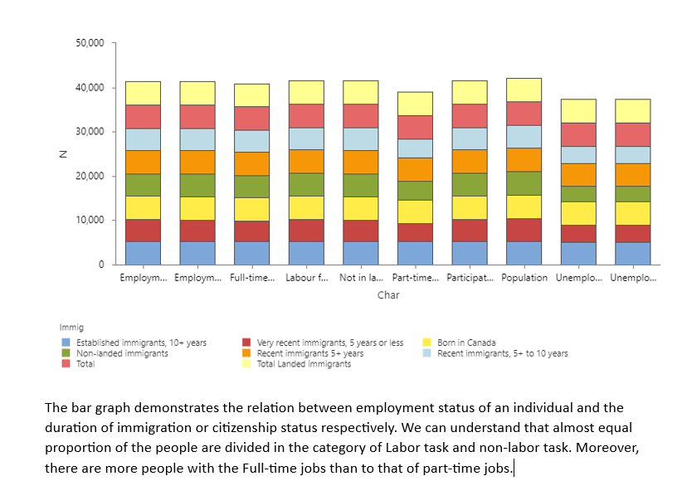
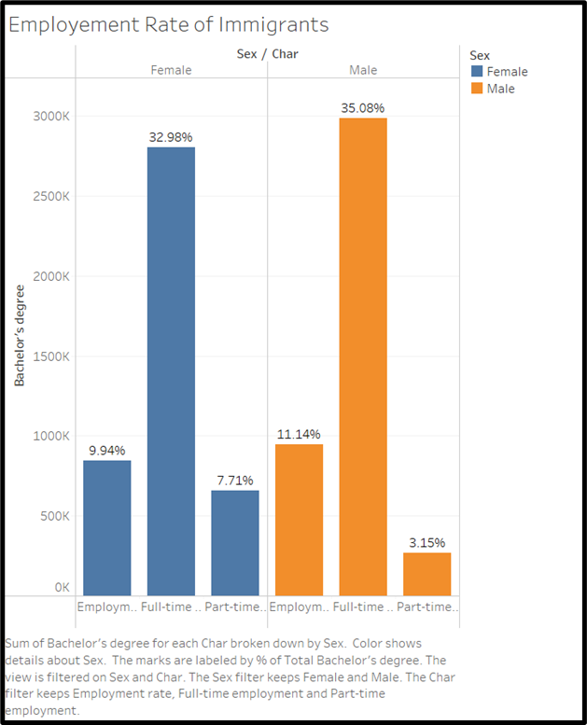
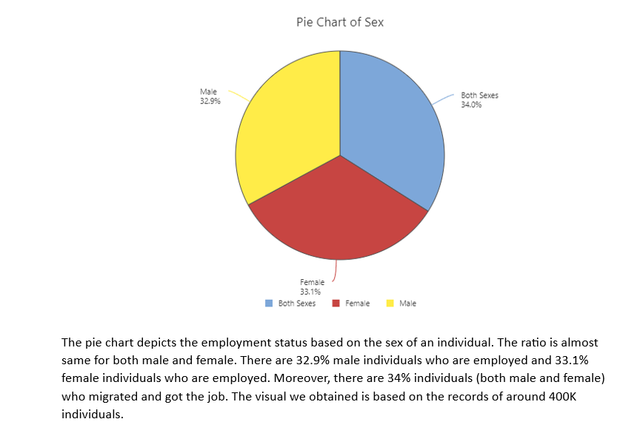
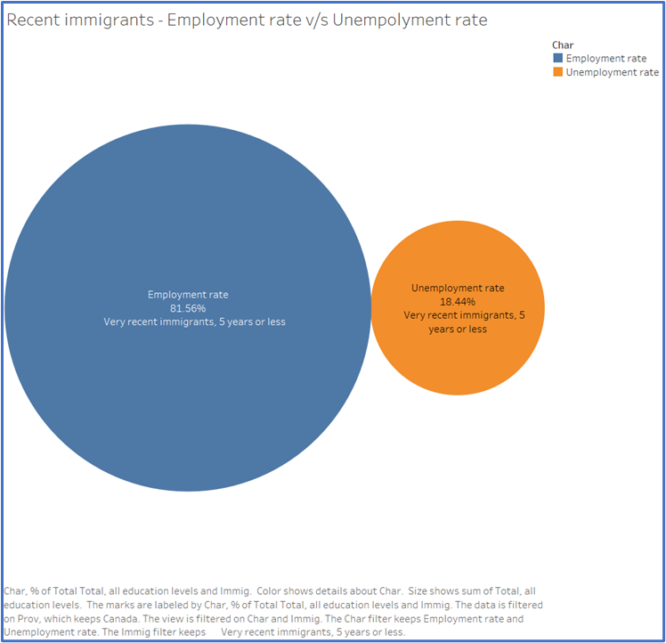
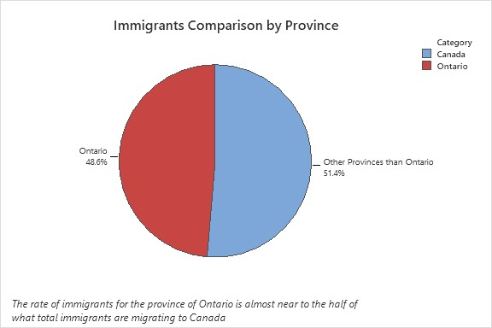
Infographics of labor immigration
Abstract
Categorical Graphs
The Labour Force estimates by immigration data source offer a useful chance to investigate the connections, patterns, and specifics relating to the effects of numerous variables on job status. The goal of this study is to better understand how immigration status, duration of immigration, educational attainment, sex, and age affect immigrant population employment status. We want to draw important conclusions from this data that will help shape policies and tactics for integrating immigrants into the labour market.
Objectives
The objective of this study is to investigate the relationships, trends, and facts related to employment status among individuals with varying immigration status, length of immigration, level of education, sex, and age. The central focus is to explore how these demographic factors influence employment status and identify any potential patterns or associations that may emerge.

